Slide 1
Presentation about myself
Aimen Imran
24042

Slide 2
Some basic information
My name is Aimen Imran
I was born and raised in Karachi.
I am currently pursuing a Bachelors in Business Administration (BBA) from Institute of Business Administration(IBA)

Slide 3
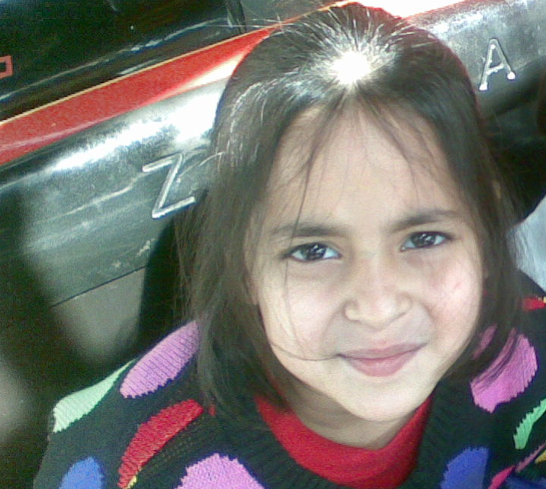
This is a picture of me when I was 6 years old

Slide 4
Myself
Honest
Reliable
Friendly
Hardworking

Slide 5
My goals
I plan to work at a corporate organization, after completing my BBA
I also aim to pursue further education and get my masters in business administration (MBA)
One of major aim is also to give back to the society and help the people around me in every way I can.
I also want to travel to all my places on my bucket list like Maldives.

Slide 6
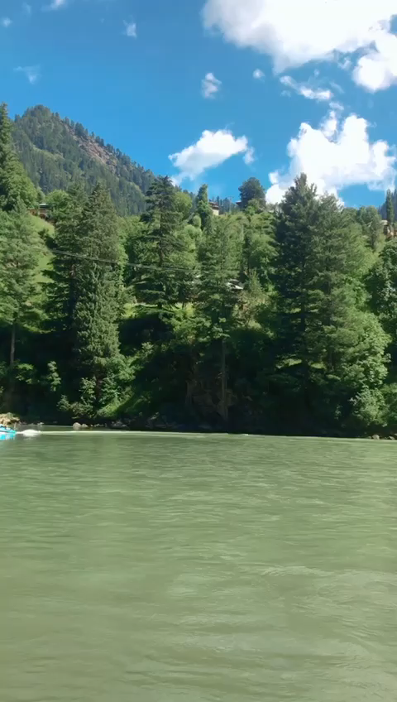
Kashmir
Here is a video of Sharda,Kashmir I made when I went to Kashmir recently and ticked it off my bucket list.

Slide 7
Payback to the society
After my education, and becoming independent, I want to pay back and contribute to the society, by helping others who are in need.
Want to assist financially
Want give time for community work.
Want to do career counselling to the students.

Slide 8

My hobbies
Binge watching shows:
I spend most of my day being lazy, lying doing in my bed and watching shows mostly on Netflix.
My most favorite show which I’ve watched countless times is Gilmore Girls.

Slide 9
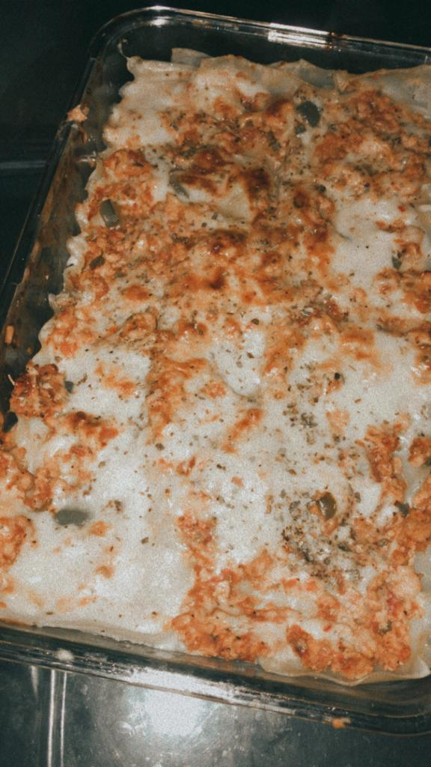
My hobbies
Baking:
On days when I’m not lazy and craving something good to eat I bake.
I make scrumptious lasagna and cookies.
Here is a picture of a lasagna I made

Slide 10

My Hobbies
Listening to music:
I love to listen to both English and Urdu songs
One of my favorite singer is Shawn Mendes.

Slide 11
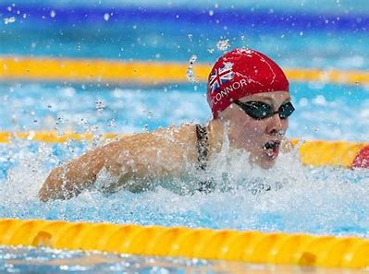
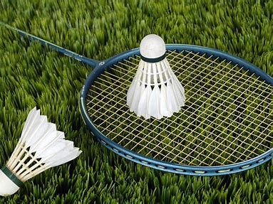
Athletics
Sometimes I like to play sports .
I am quite good at
Swimming
Badminton

Slide 12
Reflecting on ICA
This course has been an amazing learning experience with Sir Waseem Arain.
I’ve learned a lot of new features in MS Word, MS Excel and MS Powerpoint which will help me in my professional life.
I’ve also learned GIT and improved my typing skills.
Overall it has been a very productive course and I really enjoyed it.

